Slide 1
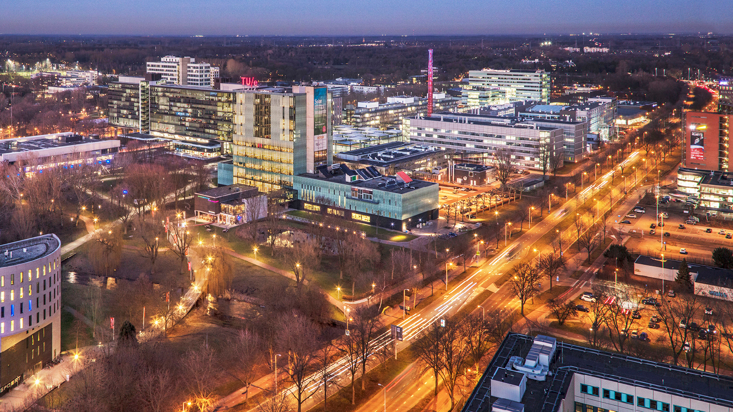
Machine learning based models for heat and flow systems: Mixture Density Network
20.06.2024
Final presentation, Group 2
4AI000

Slide 2
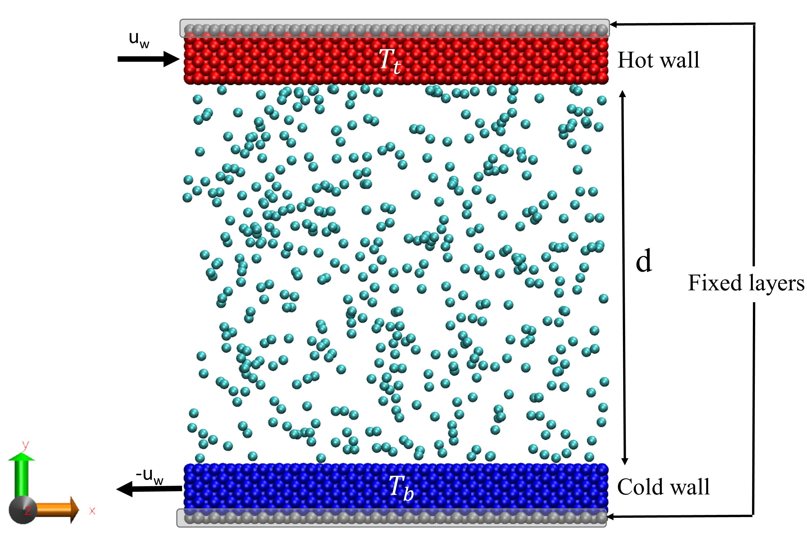
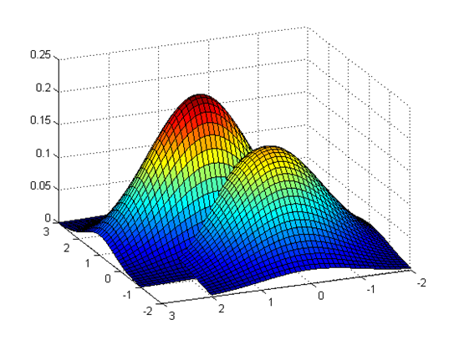
Background
Collision model (scattering kernel) serves as boundary conditions for Boltzmann equations and aims at describing how gas atoms are reflected after collision with the wall at temperature
Most of collision models in literature are parametric models (Example: Maxwell model, ACL etc.)
Limitations: Limited number of constant accommodation coefficients, Lack of flexibility in the case of complex collision data
Existing solution^{[1]} - Reconstructing the collision behaviour of system using GMM
Notes:
It suggests that to achieve better accuracy we need to rely on the whole data range and to not be limited by the number of model parameters.

Slide 3
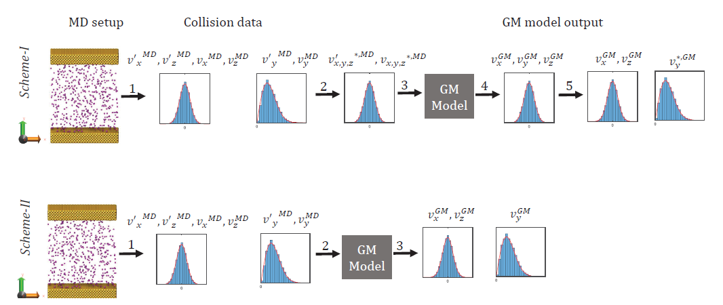
Existing method using GMM
Construction of a statistical model of gas-wall interaction based on the data issued from MD (Molecular dynamics) simulations and use them to predict the velocities and other relevant parameters.^{[1]}
A GMM (Gaussian Mixture model), an unsupervised machine learning technique is used.
The trained GMM predicts the physical and statistical properties.
After obtaining the predictive parameters, the scattering kernels are constructed and cross referenced with the MD simulations to verify the performance of the model.
[1]

Slide 4
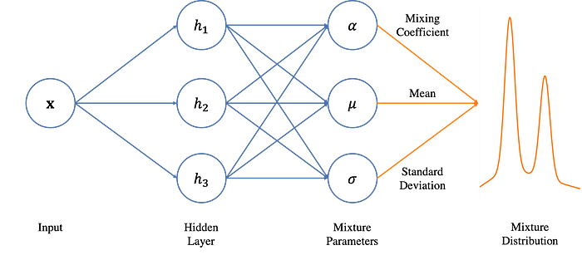
Proposal: Mixture Density Networks (MDN)^{[2]}
CLASSICAL APPROACH
Collision Data (given)
Translational and Rotational Velocities
Scattering Kernels
Compute ACs
OBJECTIVE 2
PROPOSED APPROACH
OBJECTIVE 1
Density Estimation using Neural Network (MDN)

Slide 5
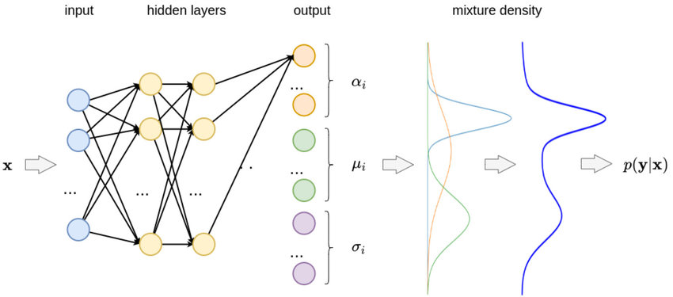
Execution
Data pre-process and visualization
Collate the collision data from MD simulation
Apply transformation (Rayleigh to Gaussian, if needed)
Normalization
Define input features
Wall Temperature, Translation velocity and Rotational velocity
Define MDN
architecture
Train the model
Model Evaluation
Optimal number of Mixes
Compare ACs of MDN, GMM and MD
Calculate ACs
Scattering Kernels
Hyper-parameter Tuning
Planned objectives
To implement and train MDN for individual components and obtain the GMs
Calculate the Accommodation Coefficients for iso/non-iso thermal and flow/no-flow conditions using the results
Tune the model with number of mixes as one of the hyper-parameters (not possible in unsupervised GMM)
Compare the results from MDN for individual components with MD simulation and previous GMM research
Extend the MDN for multi-dimensional features and compare its results

Slide 6
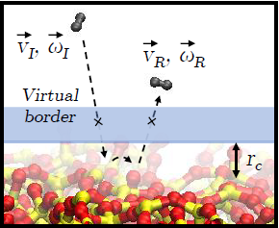
Features
V_{I}: v_x_in, v_y_in, v_z_in,
ω_{I}: omega_1_in, , omega_2_in
V_{O}: v_x_out, v_y_out, v_z_out
ω_{O}: omega_1_out, omega_2_out
For,
Argon – Isothermal walls – without flow (only V_{I} and V_{O})
H₂ – Isothermal walls – with/without flow
H₂ – Non-isothermal walls – with/without flow

Slide 7
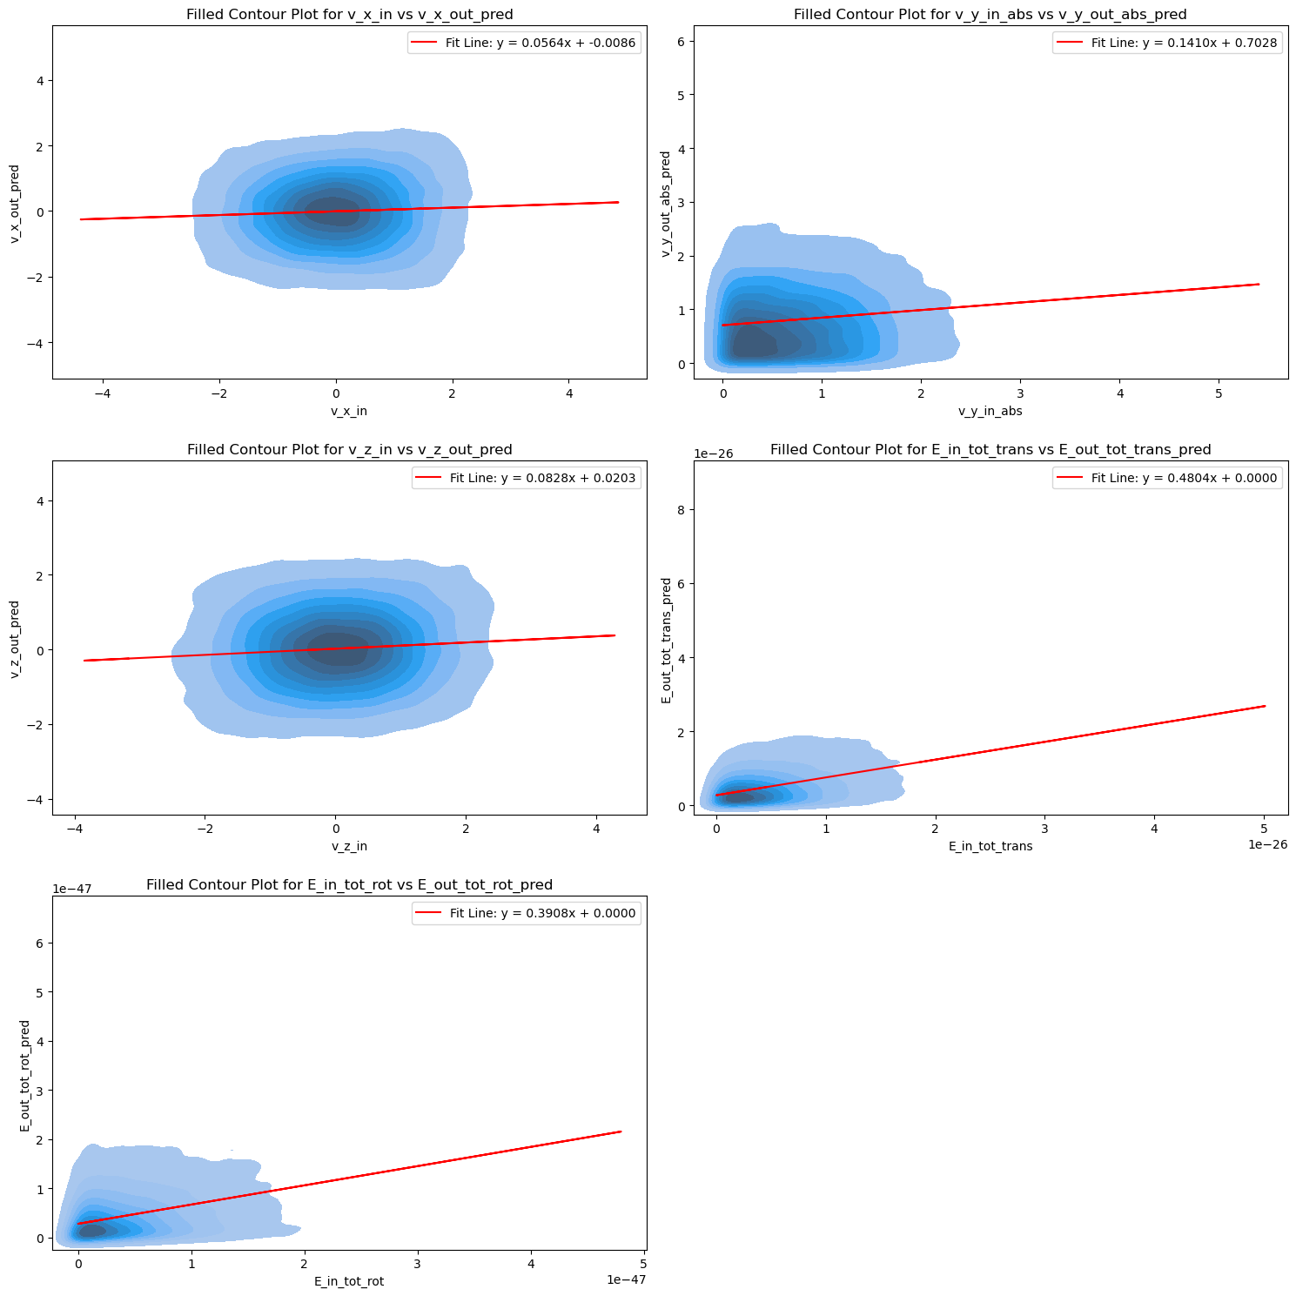
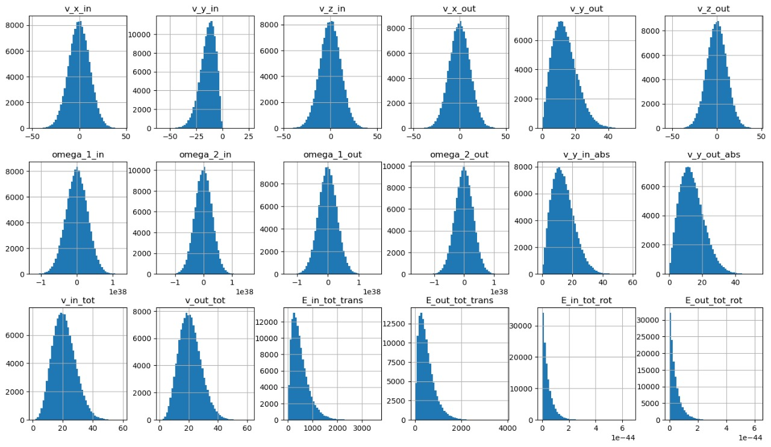
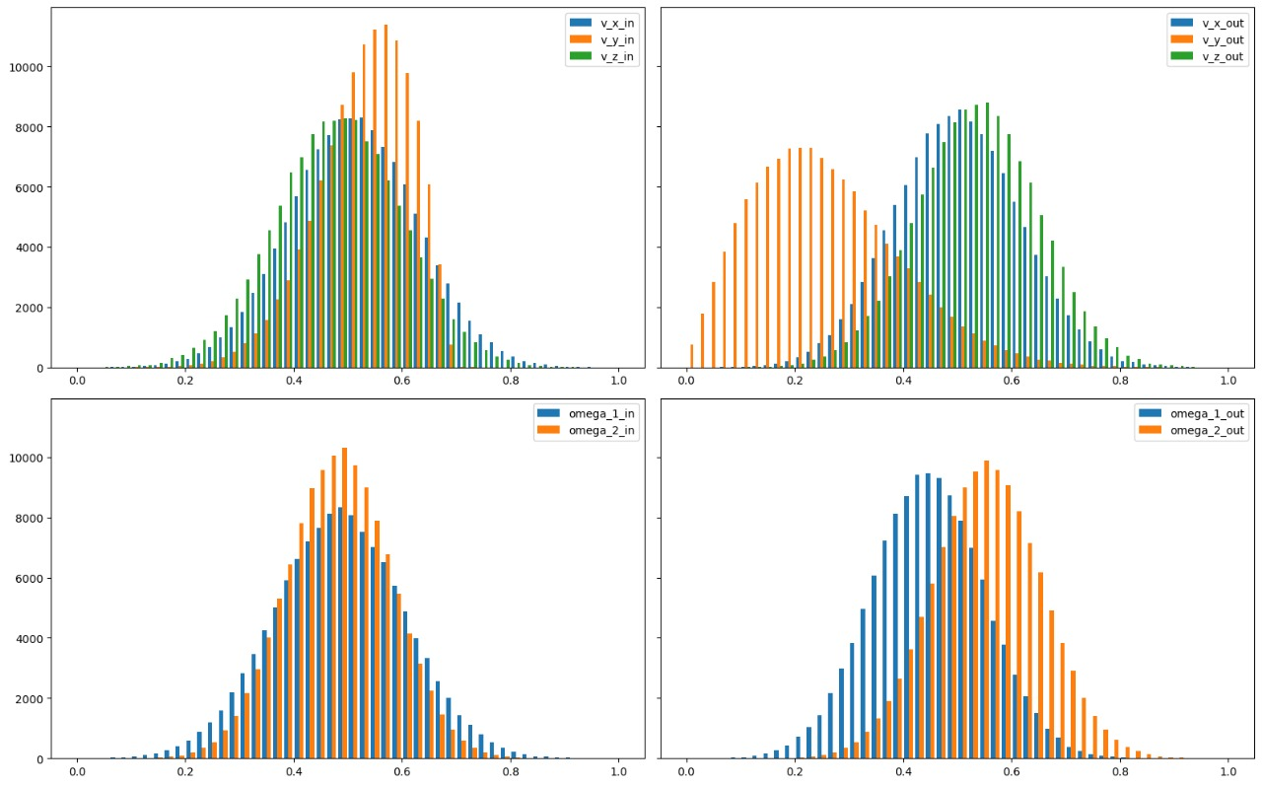
Data pre-preprocess and visualization
Read raw data as a Pandas data-frame, calculate energy components based on the molecular mass, visualize all the components. (Not scaled)
Compute the AC using
velocity correlation for raw data to establish ground truth value for ACs (Not scaled)
Prepare train, test and validation data set for the selected components Vx, Vy, Vz
(Scaled using Standard scaler)
Extract required components to be predicted (Vx, Vy, Vz)

Slide 8
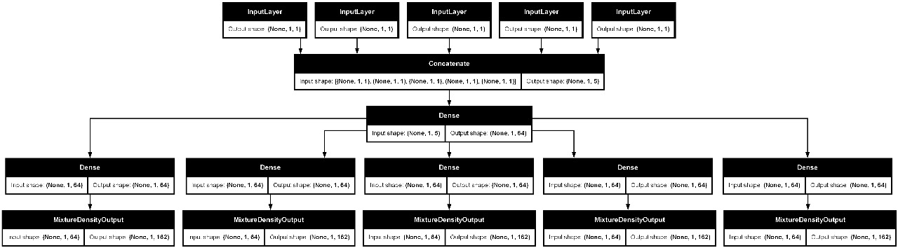
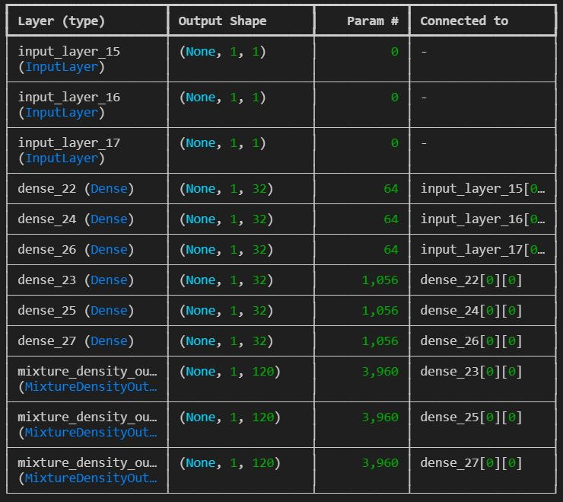
Mixture Density Network (MDN)
Reshape the input and output tensors (Translational and rotational velocities)
Define
MDN
Architecture
MDN has three outputs: Mean, Variance and Mixture co-efficient
Different Activation functions are used for each of these outputs
Variance: Exponential linear unit + 1 + epsilon (a very small value)
Mixture co-efficient: SoftMax
Loss function: Maximize the Likelihood -> Minimize the negative of (log) Likelihood

Slide 9
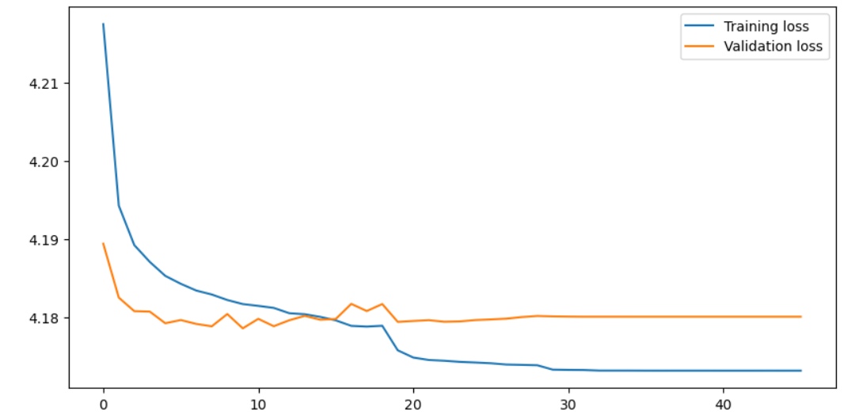
Training and validation
Training
The goal here is to maximize the log likelihood, which means the MDN will learn how to reduce the negative log likelihood.
Loss function: Negative Log Likelihood
Learning rate adapts for each epoch
Validation
The goal here is to measure the rate of underfit or overfit.
The data required for validation is taken from the training data
Used for hyper-parameter tuning
Train-Test-Validation split
Test - 30%, Train - 70% , 20% of train data

Slide 10
Hyper-parameter tuning : Search space and optimization
Initial search space (Random search)
Modified search space (Bayesian Opt.)
Hyper-parameter | Possible values
No. of mixes | 10 - 100
Learning rate | 0.0001 - 0.1
Optimizer | Choice_O
Dropout | True, False
Dropout rate | 0.05 - 0.75
Activation | Choice_A
No. of layers | 1 - 10
No. of neurons | 32 - 128
Hyper-parameter | Possible values
No. of mixes | 10 - 100
Activation | Choice_A
No. of layers | [1, 2]
No. of neurons | [32, 64]
Best values obtained for H2 - Ni system, isothermal, without flow
After HP tuning
Modify search space
Hyper-parameter | Best Value
No. of mixes | 44
Activation | Relu
No. of layers | 1
No. of neurons | 32
Choice_O = [Adam, nadam, Adamw, adadelta]
Choice_A = [Relu, tanh, sigmoid, leaky-relu, ELU]

Slide 11
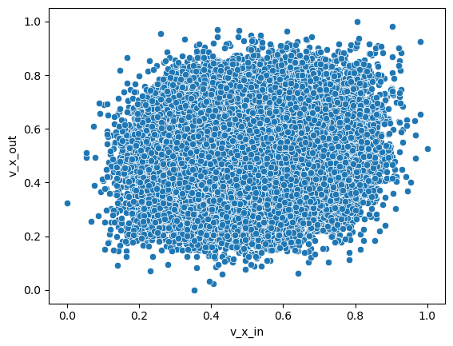
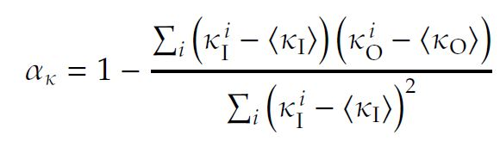
Computing ACs using velocity correlation method
[6]
β - Slope of best fit line
C - Intercept of best fit line
AC = 1 - β
Fit Line
Diffusive wall
Reflective wall
The method of evaluating AC using velocity correlation is based on finding the slope of the best (least squares) fit line
Calculate the ACs both the original and predicted (test) data.
To evaluate the accuracy of MDN.
In case of computing ACs for rotational velocities, the moment of inertia is used to plot (center of mass of the molecule is used)

Slide 12
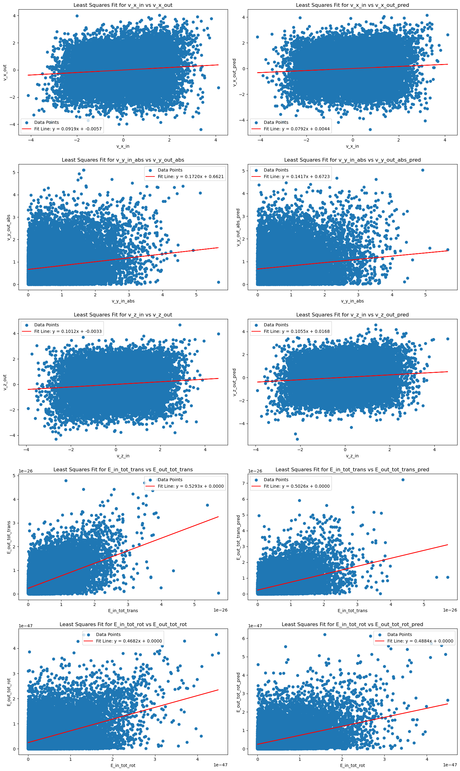
Results - ACs (plots)

Slide 13
Results - Comparison of ACs
 | Set up | Vx | Vy | Vz | E_trans
Isothermal | MD | 0.876 | - | 0.888 | 0.873
 | GMM | 0.879 | - | 0.888 | 0.884
 | % change | 0.342 |  | 0.000 | 1.26
Ar-Au system (Mono-atomic)
For given MD data
[5]
 | Set up | Vx | Vy | Vz | E_trans
Isothermal | MD | 0.877 | 0.955 | 0.880 | 0.889
 | MDN | 0.866 | 0.950 | 0.887 | 0.901
 | % change | 1.25 | 0.52 | 0.79 | 1.34
Ar-Au system (mono-atomic)
Test data

Slide 14
 | Set up | Vx | Vy | Vz | E_trans | E_rot
Isothermal | MD | 0.958 | 0.797 | 0.955 | 0.526 | 0.666
 | GMM | 0.958 | 0.798 | 0.954 | 0.558 | 0.700
 | % change | 0.000 | 0.125 | 0.125 | 6.083 | 5.105
Isothermal (with flow) 20 | MD | 0.942 | 0.743 | 0.933 | 0.432 | 0.610
 | GMM | 0.940 | 0.742 | 0.931 | 0.466 | 0.651
 | % change | 0.212 | 0.134 | 0.214 | 7.870 | 6.721
H₂-Ni system (di-atomic)
MD data
[5]
 | Set up | Vx | Vy | Vz | E_trans | E_rot
Isothermal | MD | 0.960 | 0.875 | 0.965 | 0.584 | 0.650
 | MDN | 0.946 | 0.885 | 0.965 | 0.603 | 0.681
 | % change | 1.452 | 1.142 | 0.000 | 3.25 | 4.76
Isothermal (with flow) 20 | MD | 0.937 | 0.863 | 0.932 | 0.522 | 0.614
 | MDN | 0.943 | 0.859 | 0.917 | 0.519 | 0.609
 | % change | 0.640 | 0.463 | 1.602 | 0.574 | 0.81
H₂-Ni system (di-atomic)
Test data

Slide 15
Non-isothermal | Set up | Vx | Vy | Vz | E_trans | E_rot
B – 300 K | MD | 0.913 | 0.705 | 0.904 | 0.379 | 0.544
 | GMM | 0.912 | 0.709 | 0.908 | 0.421 | 0.593
 | % change | 0.109 | 0.567 | 0.442 | 11.081 | 9.007
T – 500 K | MD | 0.913 | 0.726 | 0.896 | 0.379 | 0.556
 | GMM | 0.916 | 0.726 | 0.892 | 0.435 | 0.590
 | % change | 0.328 | 0.000 | 0.446 | 0.147 | 6.721
H₂-Ni system (di-atomic)
MD data
(with flow)
[5]
 | Set up | Vx | Vy | Vz | E_trans | E_rot
B – 300 K | MD | 0.908 | 0.828 | 0.898 | 0.470 | 0.531
 | MDN | 0.920 | 0.858 | 0.894 | 0.490 | 0.511
 | % change | 1.321 | 3.62 | 0.445 | 4.251 | 3.766
T – 500 K | MD | 0.918 | 0.868 | 0.903 | 0.543 | 0.559
 | MDN | 0.920 | 0.851 | 0.899 | 0.517 | 0.588
 | % change | 0.217 | 1.958 | 0.442 | 4.78 | 5.18
H₂-Ni system (di-atomic)
Test data
(with flow)

Slide 16
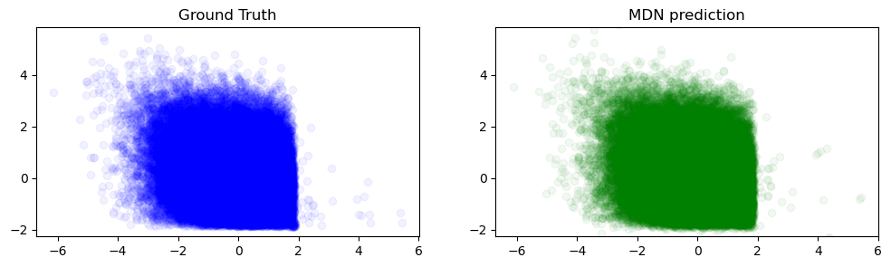
Conclusion
Advantages
MDN learns the Rayleigh distribution without requiring (Liao) transformations
Feature extraction + prediction in one step (GMM requires separate feature extraction step for better performance)
Hyper-parameter tuning allows us to arrive at the optimal number of mixtures, unlike in GMM.
Has very good performance on unseen (test) data
Limitations and future work​
Hyper-parameter tuning requires more time and high computational power
MDN may tend to overfit the data
Scaling the data (for training NN) causes minor changes in AC values
Future work
Try to use MDN to directly predict the AC for total energy
Non iso-thermal, with flow conditions

Slide 17
References
Meng Liao, Quy-Dong To, Céline Léonard, Wenlu Yang. Prediction of thermal conductance and friction coefficients at solid-gas interface from statistical learning of collisions. Physical Review E , 2018.
Bishop, C. M. Mixture Density Networks. Technical report, Aston University, 1994.
Jie Chen, Yang Yu, Yongming Liu, Physics-guided mixture density networks for uncertainty quantification, Reliability Engineering & System Safety, Volume 228, 2022, 108823, ISSN 0951-8320, https://doi.org/10.1016/j.ress.2022.108823
https://deep-and-shallow.com/2021/03/20/mixture-density-networks-probabilistic-regression-for-uncertainty-estimation
Mohammad Nejad, S. (2023). Scattering dynamics of rarefied gases: A hybrid atomistic/machine learning approach. [Phd Thesis 1 (Research TU/e / Graduation TU/e), Mechanical Engineering]. Eindhoven University of Technology.
Spijker, P. (2009). Exploring the boundaries of molecular modeling : a study of nanochannels and transmembrane proteins. [Phd Thesis 1 (Research TU/e / Graduation TU/e), Biomedical Engineering]. Technische Universiteit Eindhoven. https://doi.org/10.6100/IR642681

